Slide 1
Priya Dairies Fresh from Farm to Your Doorstep
Group 3
Vinay Kotagiri
Vandana Lona
Surya Teja Guduri
Md Abdullah AI Mamun
Sriram Reddy Palda

Slide 2
Agenda
Background
Problem Opportunity
ERD
Context Level DFD
Level 0 and Level 1 DFD
System Overview

Slide 3
Fresh Dairy Promise: Priya Dairies guarantees the sale of only same-day-sourced dairy products, ensuring freshness and quality for customers.
Focused Supply Chain: Operates through direct sourcing from suppliers to minimize wastage and balance supply-demand mismatches.
Background

Slide 4
Problem
Supply-Demand Mismatch: India faces significant wastage in dairy products due to overproduction and the inability to meet dynamic consumer demand.
Customer Convenience: Locating fresh dairy products often requires time-consuming efforts, leading to dissatisfaction.

Slide 5

Opportunity
Guaranteed Freshness: Priya Dairies bridges the gap by offering only same-day-sourced products, making it a trusted choice for customers.
Minimized Wastage: Efficient demand forecasting and direct supplier sourcing reduce product spoilage, benefitting both suppliers and consumers.
Tech-Enabled Access: An online platform facilitates easy ordering for selective communities, promoting convenience and scalability.

Slide 6
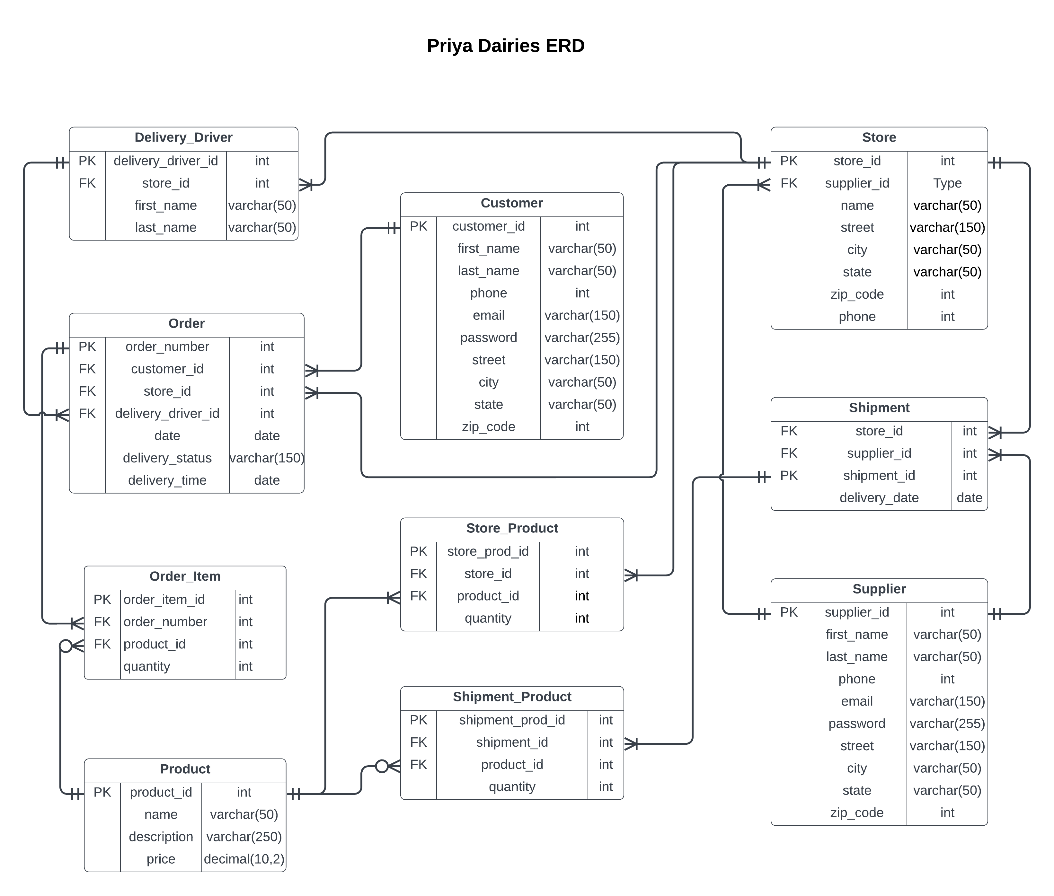
ERD

Slide 7
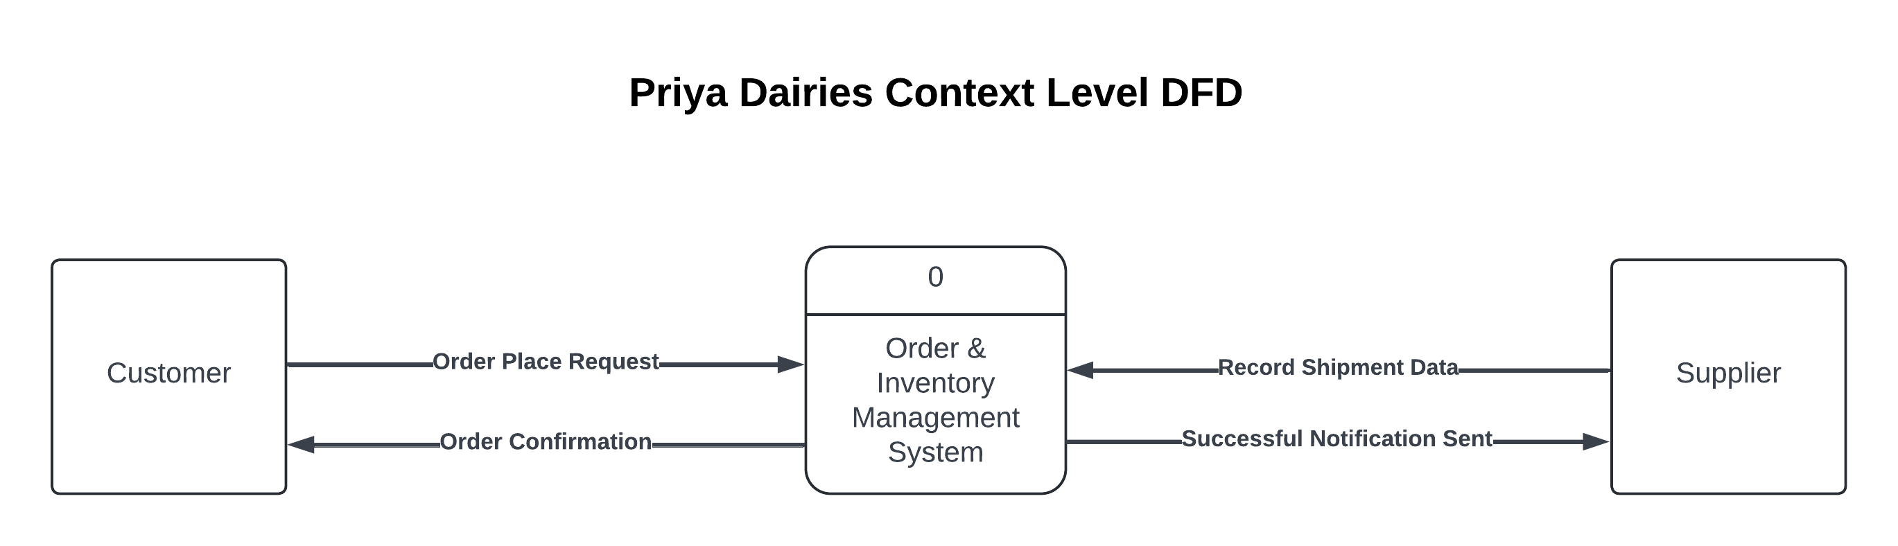
Context Level DFD

Slide 8
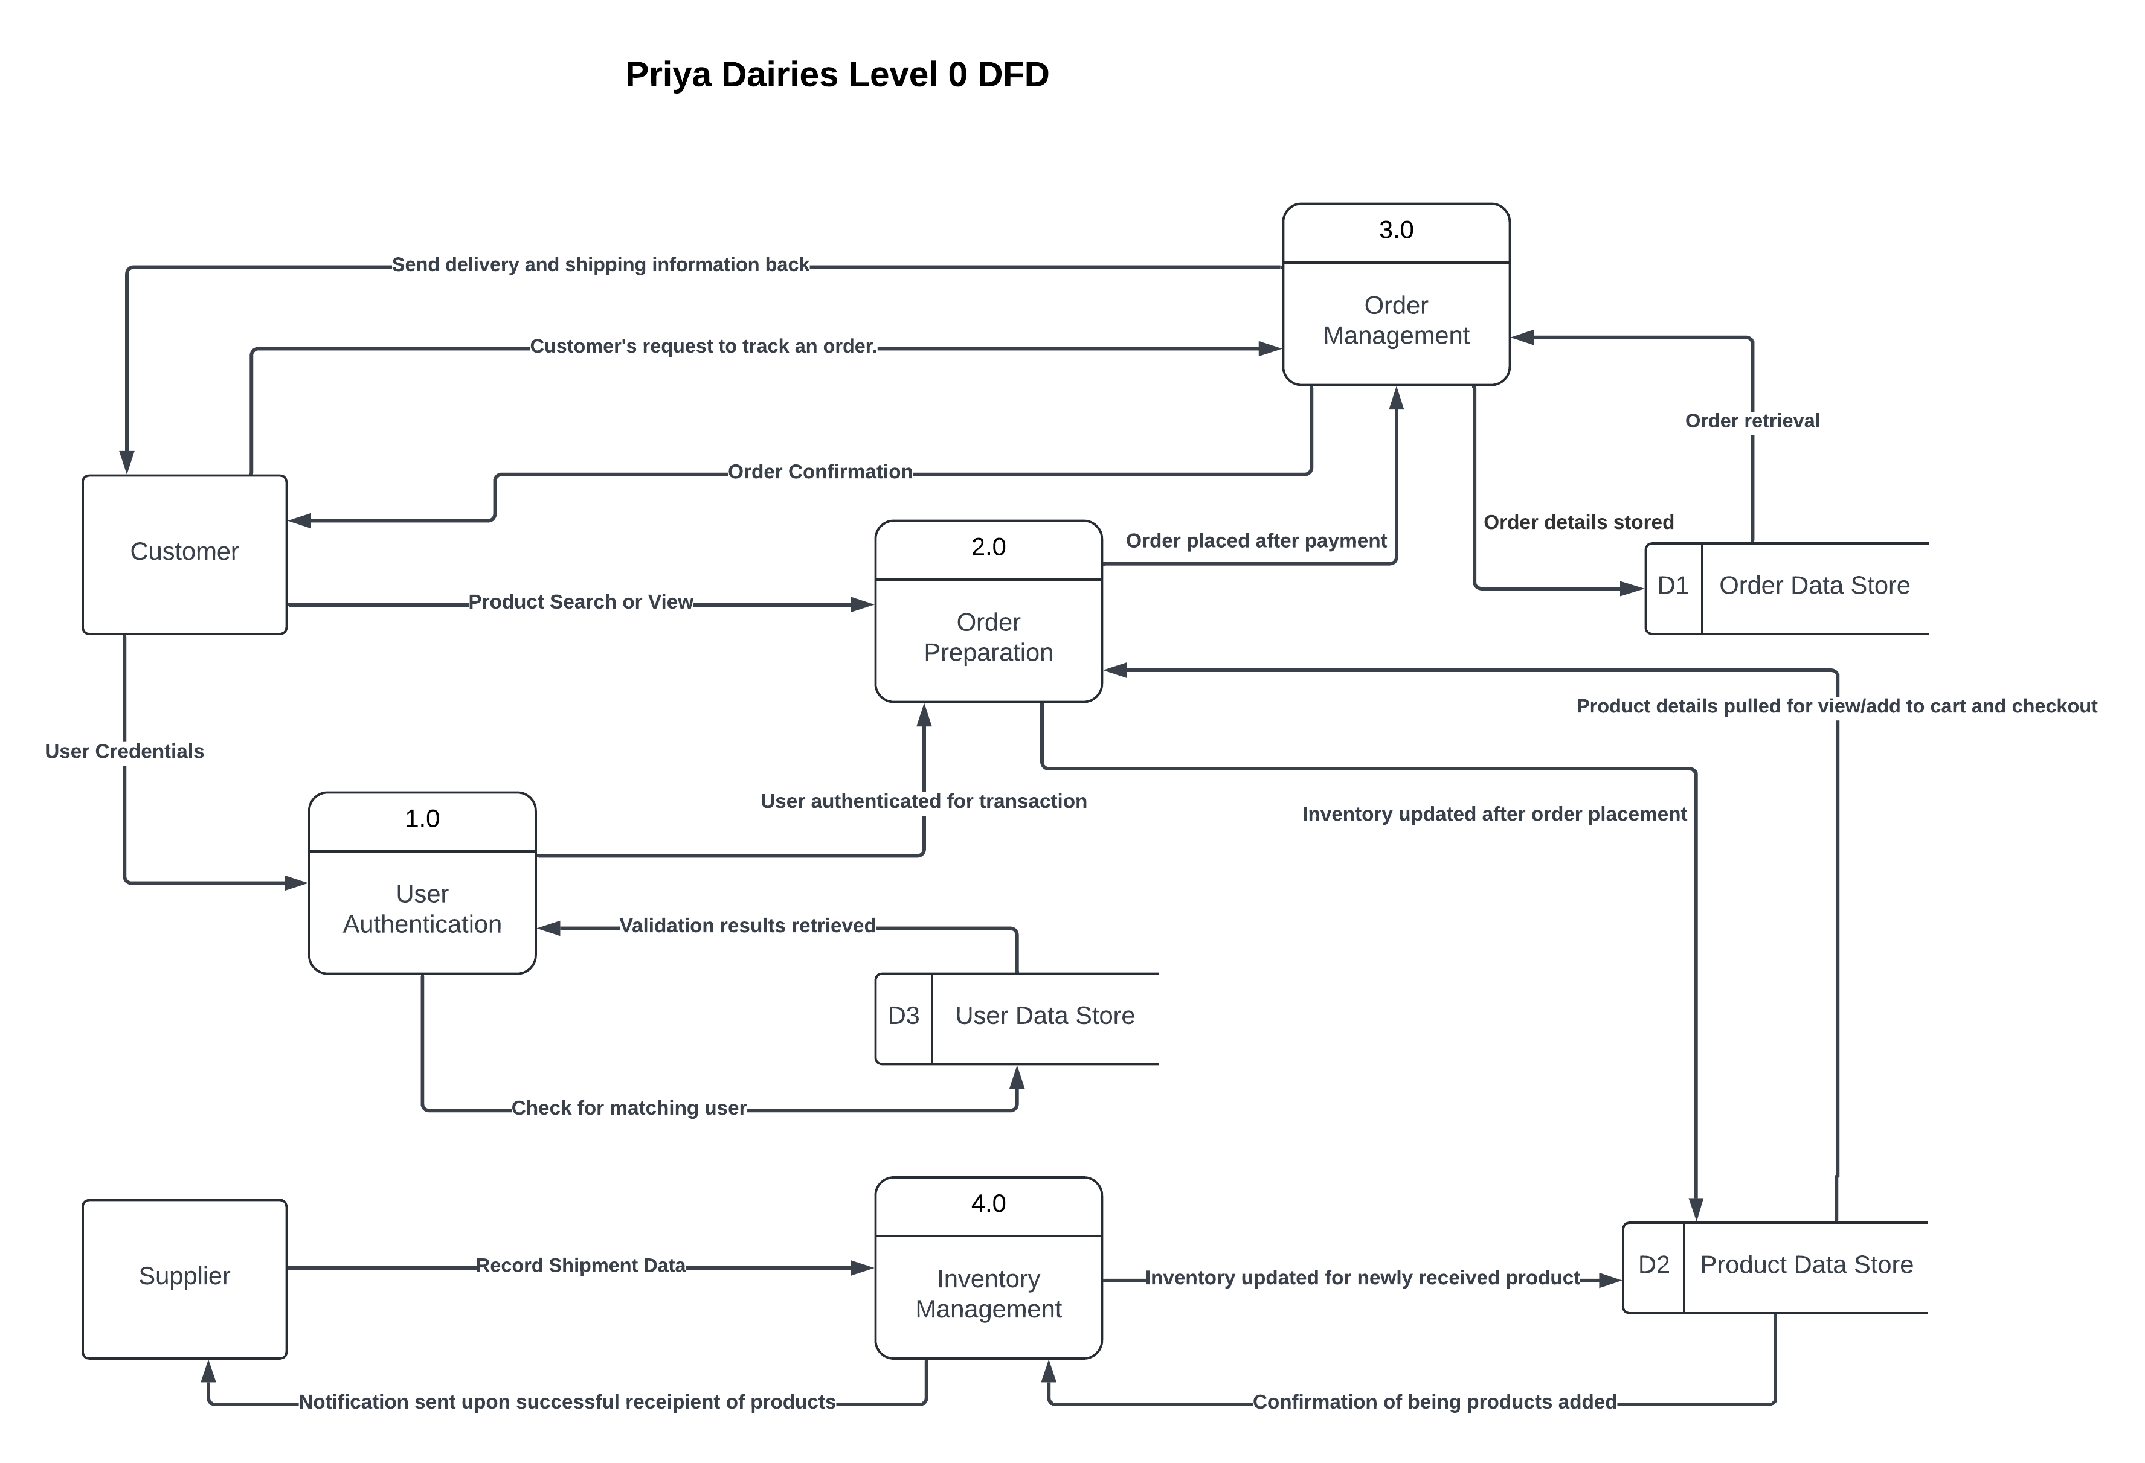
Level 0 DFD

Slide 9
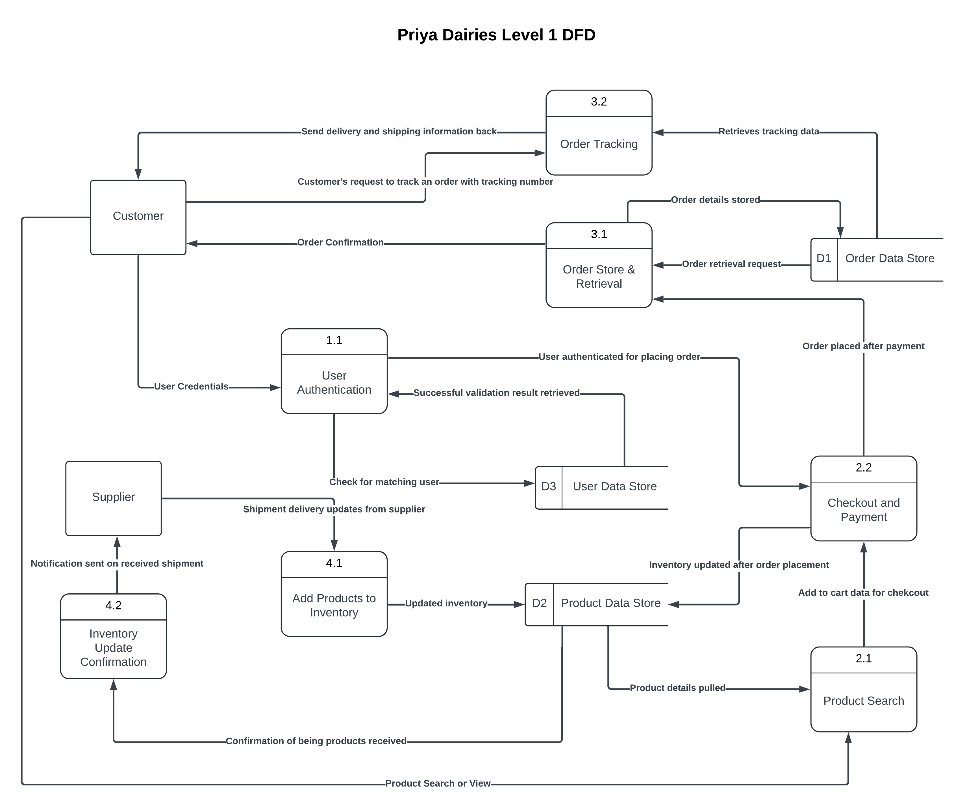
Level 1 DFD

Slide 10
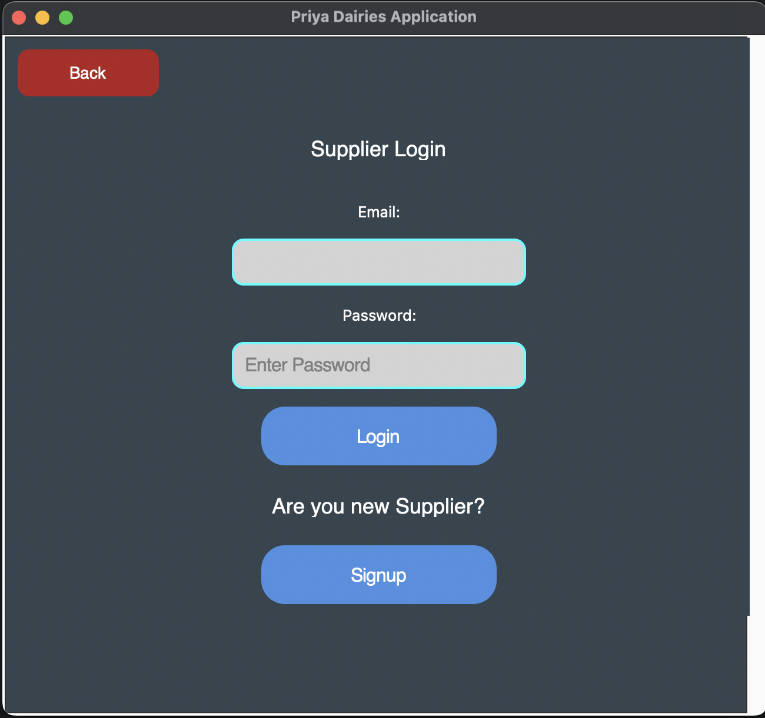
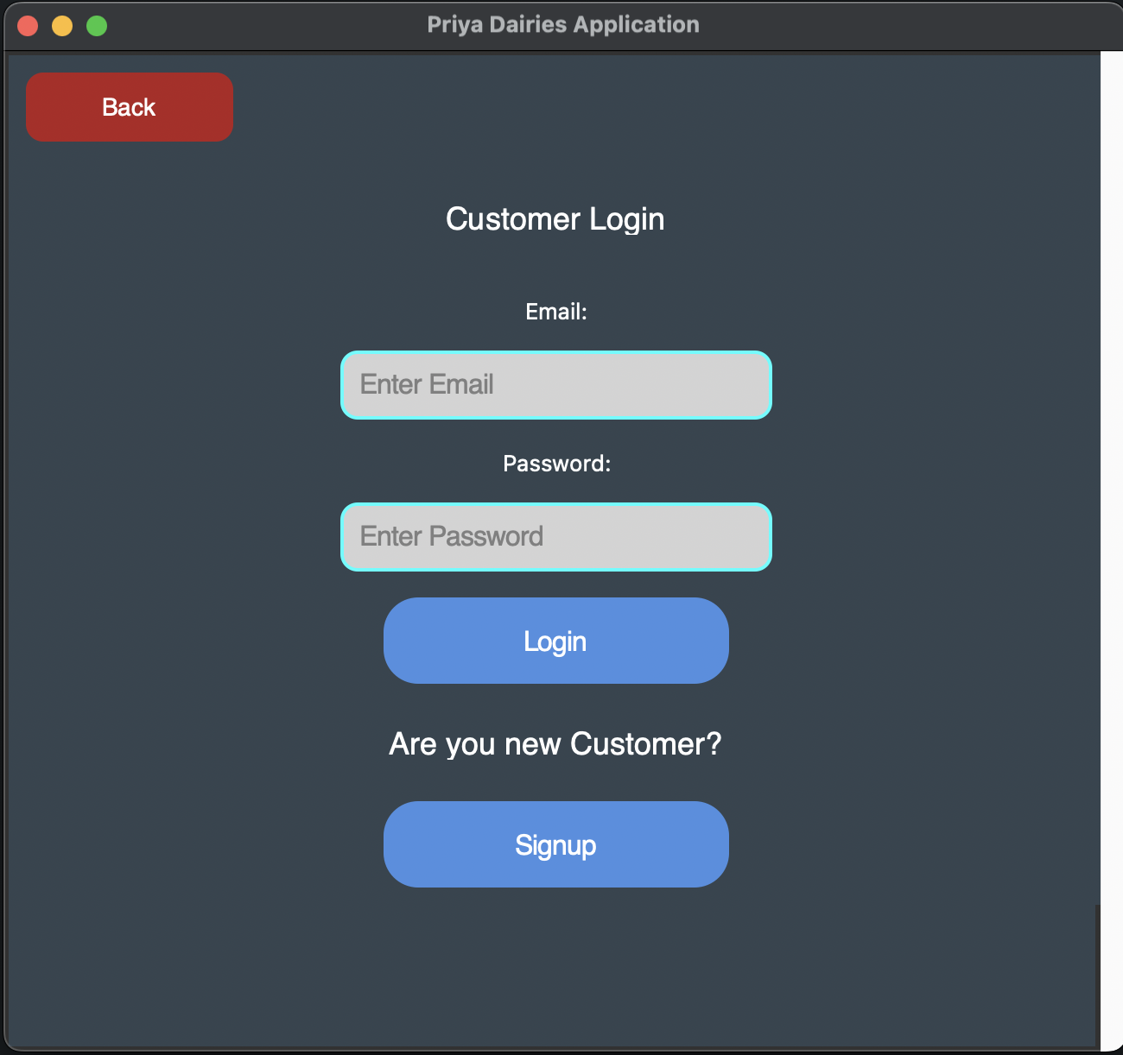
Customer and Supplier Login

Slide 11
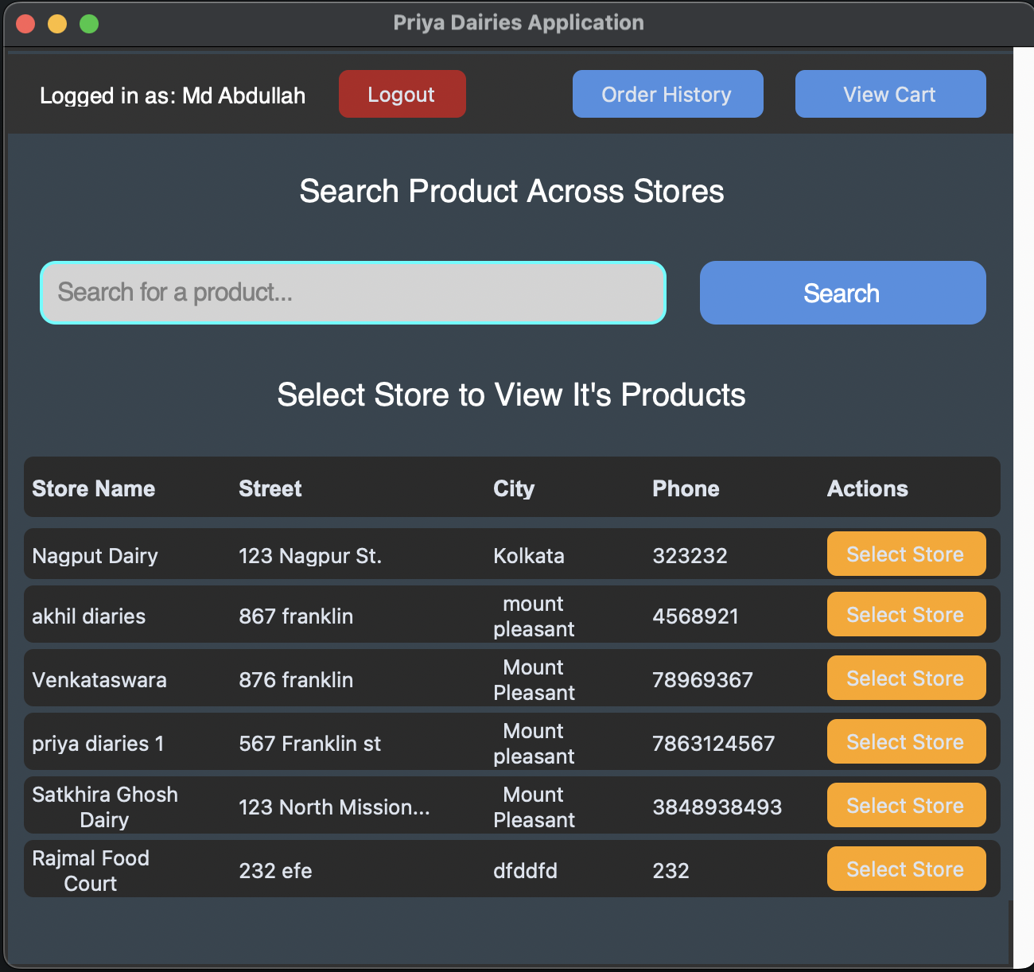
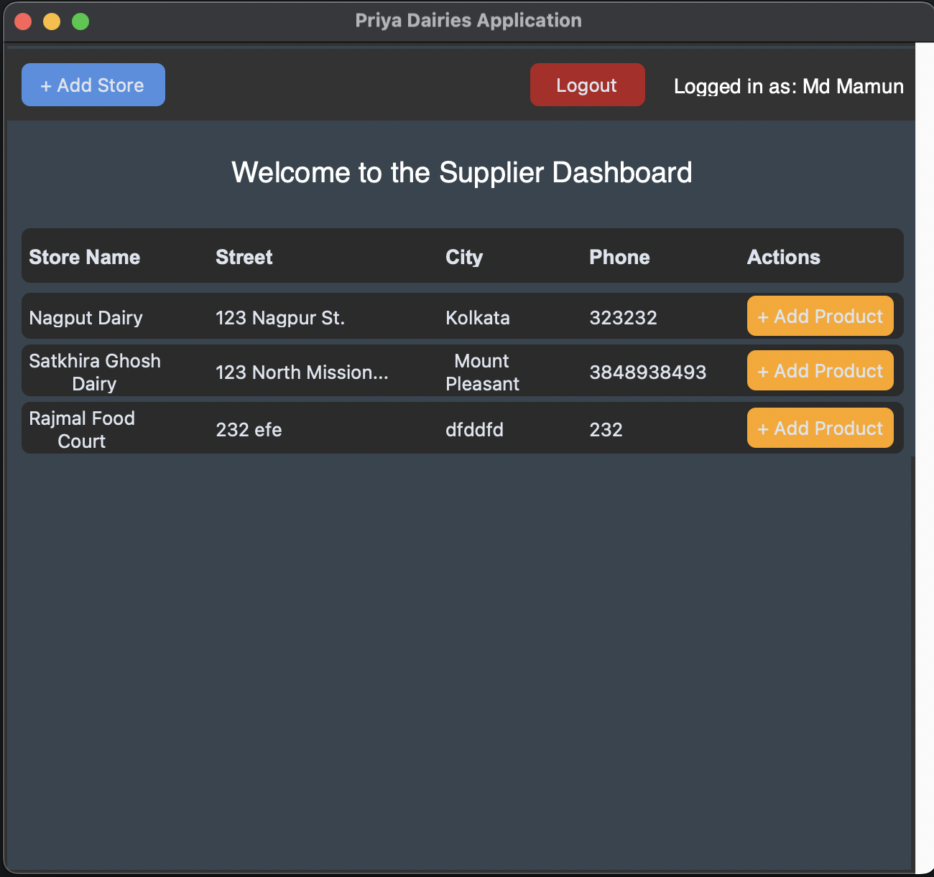
Customer and Supplier Dashboard

Slide 12
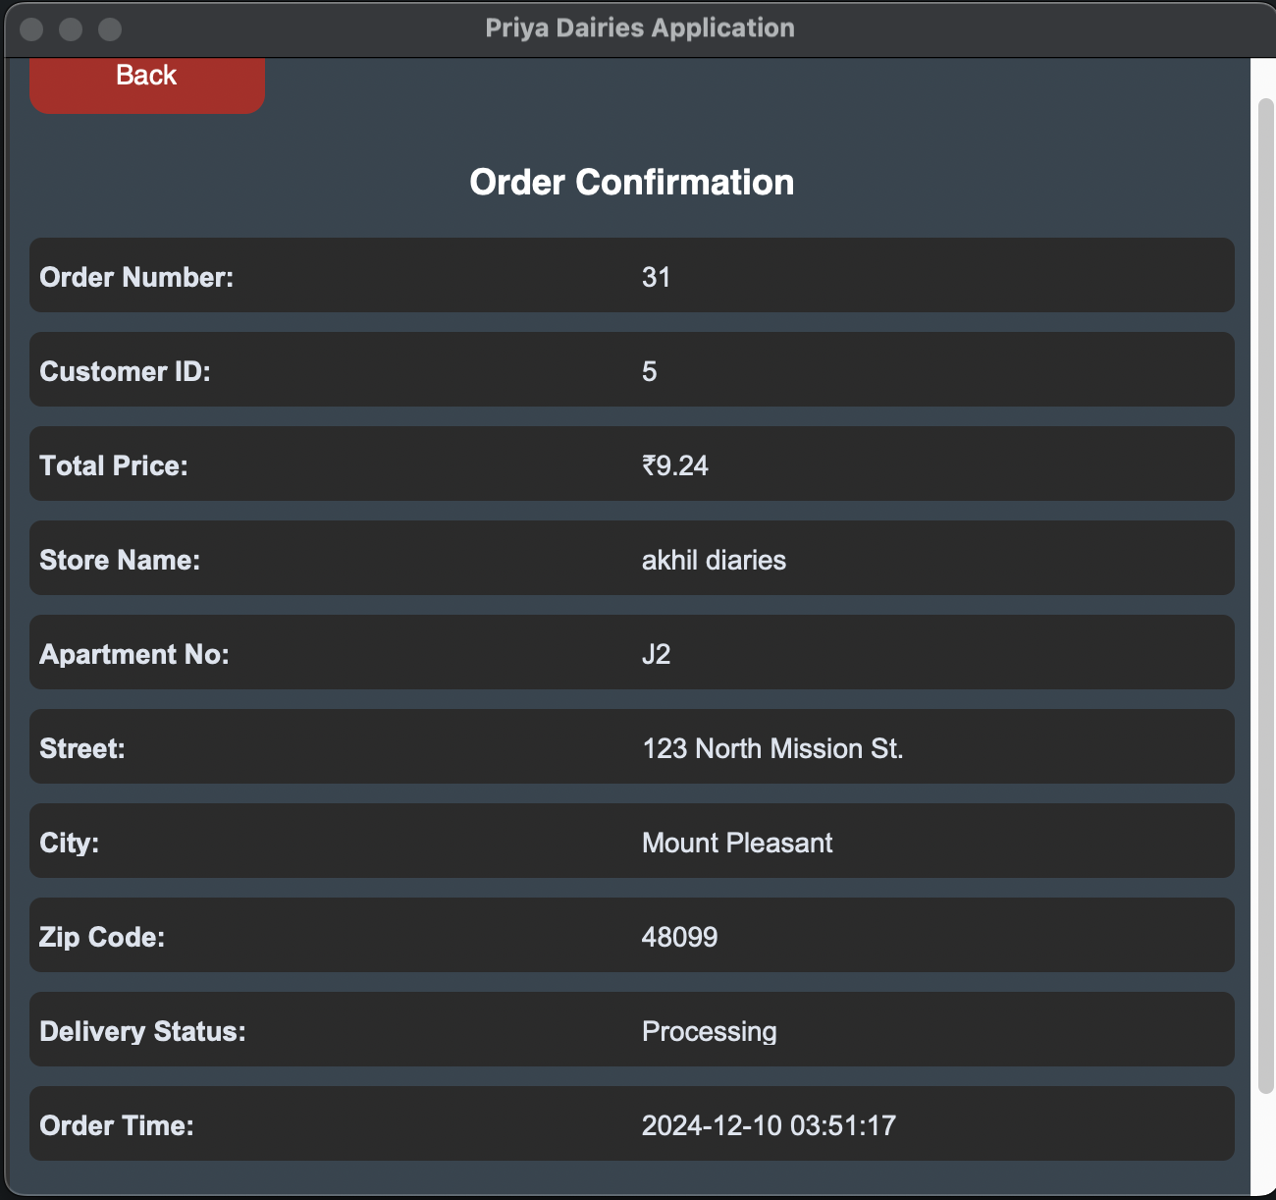
Order Confirmation

Slide 13
System Demonstration

